Slide 1
CREATE A CLOUDWATCH USING EC2 INSTANCE ON TERRAFORM

Slide 2
CLOUDWATCH
Amazon CloudWatch is a monitoring and observability service designed for AWS cloud resources and applications. It provides real-time insights into resource utilization, application performance, and operational health. Here are some key features:
Metrics: Collect and track metrics from AWS services and custom applications, allowing you to visualize performance data.
Logs: Centralize log data from different sources, enabling you to search, analyze, and visualize logs for troubleshooting and monitoring.

Slide 3
Alarms: Set up alarms to notify you of specific conditions, like high CPU usage or low disk space, helping you respond quickly to issues.
Dashboards: Create custom dashboards to visualize key metrics and logs, giving you an at-a-glance view of your infrastructure.
Events: Monitor for specific events and trigger actions, such as invoking an AWS Lambda function when a certain log entry appears.
Insights: Use CloudWatch Insights for deep analysis of log data, making it easier to identify trends or anomalies.

Slide 4
EC2 INSTANCE:
An EC2 instance is a virtual server in Amazon's Elastic Compute Cloud (EC2) service, which allows you to run applications in the cloud. EC2 provides scalable computing capacity, letting you launch and manage instances with varying CPU, memory, and storage configurations based on your needs.
Key Features:
Scalability: You can quickly scale up or down based on demand.
Variety of Instance Types: Options for different workloads, such as compute-optimized, memory-optimized, and storage-optimized instances.
Flexibility: You can choose the operating system, storage options, and networking features.
Pay-as-you-go Pricing: You pay only for the resources you use.

Slide 5
TERRAFORM
Terraform is an open-source infrastructure as code (IaC) tool developed by HashiCorp. It allows you to define and provision data center infrastructure using a declarative configuration language. With Terraform, you can manage resources across various cloud providers, including AWS, Azure, Google Cloud, and many others.
Key Features:
Infrastructure as Code: Define your infrastructure using configuration files that are easy to read and manage.
Provider Support: Terraform supports a wide range of cloud providers and services through a modular provider ecosystem.
State Management: Keeps track of your infrastructure state, allowing for easy updates and changes.

Slide 6
connect with git/mobaxterm/putty/visual studio
step 1:-
terraform installation commands
use this commands:
sudo su/-i
yum install -y yum-utils shadow-utils
yum-config-manager --add-repo https://rpm.releases.hashicorp.com/AmazonLinux/hashicorp.repo
yum -y install terraform
vi main.tf

Slide 7
vi main.tf here use this code
provider "aws" {
region = "us-west-2"
}
resource "aws_sns_topic" "my_sns_topic" {
name = "my-sns-topic"
}
resource "aws_sns_topic_subscription" "email_subscription" {
topic_arn = aws_sns_topic.my_sns_topic.arn
protocol = "email"
endpoint = "youremail@example.com" # Replace with your email address
}

Slide 8
resource "aws_cloudwatch_metric_alarm" "high_cpu_alarm" {
alarm_name = "HighCPUUtilization"
comparison_operator = "GreaterThanThreshold"
evaluation_periods = "1"
metric_name = "CPUUtilization"
namespace = "AWS/EC2"
period = "300"
statistic = "Average"
threshold = "80" # Trigger if CPU > 80%
alarm_description = "This alarm monitors EC2 CPU utilization"
dimensions = {
InstanceId = "i-1234567890abcdef0" # Replace with your instance ID
}

Slide 9
actions_enabled = true
alarm_actions = [aws_sns_topic.my_sns_topic.arn]
}
resource "aws_cloudwatch_dashboard" "my_dashboard" {
dashboard_name = "MyDashboard"
dashboard_body = jsonencode({
widgets = [
{
type = "metric",
properties = {
metrics = [
["AWS/EC2", "CPUUtilization", "InstanceId", "i-1234567890abcdef0"],
],
view = "timeSeries
stacked = false,

Slide 10
region = "us-west-2",
title = "EC2 CPU Utilization",
width = 6,
height = 6
}
}
]
})
}

Slide 11
step 3:-
Steps to Use This Configuration
Set Up Terraform:
Make sure you have Terraform installed and configured with your AWS credentials.
Update Configuration:
Replace “your-email@example.com” with the email address where you want to receive alerts.
Replace “your-instance-id” with the ID of your EC2 instance that you want to monitor

Slide 12
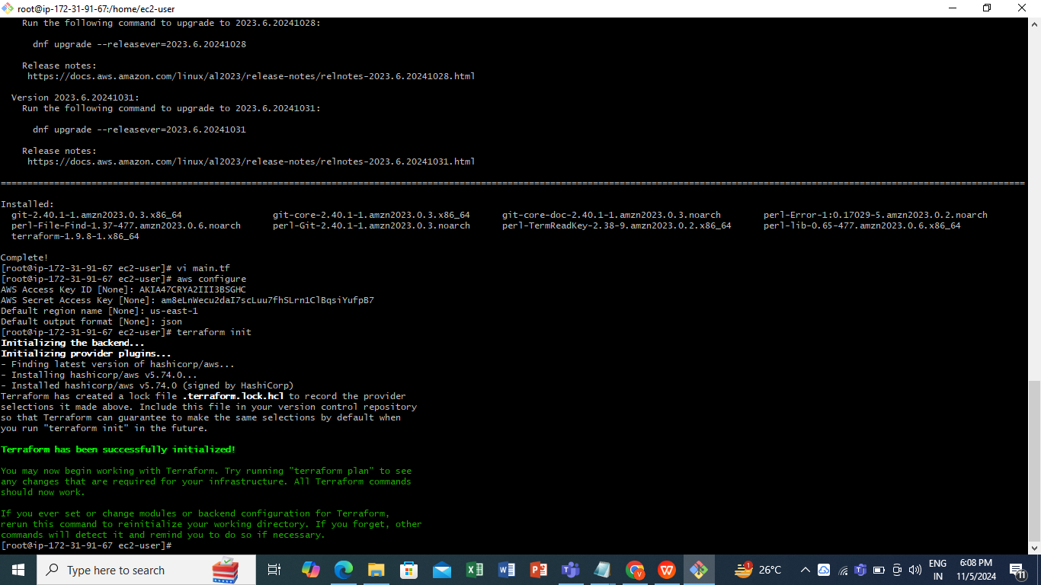
Initialize and Apply:
use this commands:
terraform init :- The command terraform init is one of the most important commands in Terraform. It is used to initialize a working directory containing Terraform configuration files. This process prepares the directory for subsequent Terraform commands like terraform plan and terraform apply

Slide 13
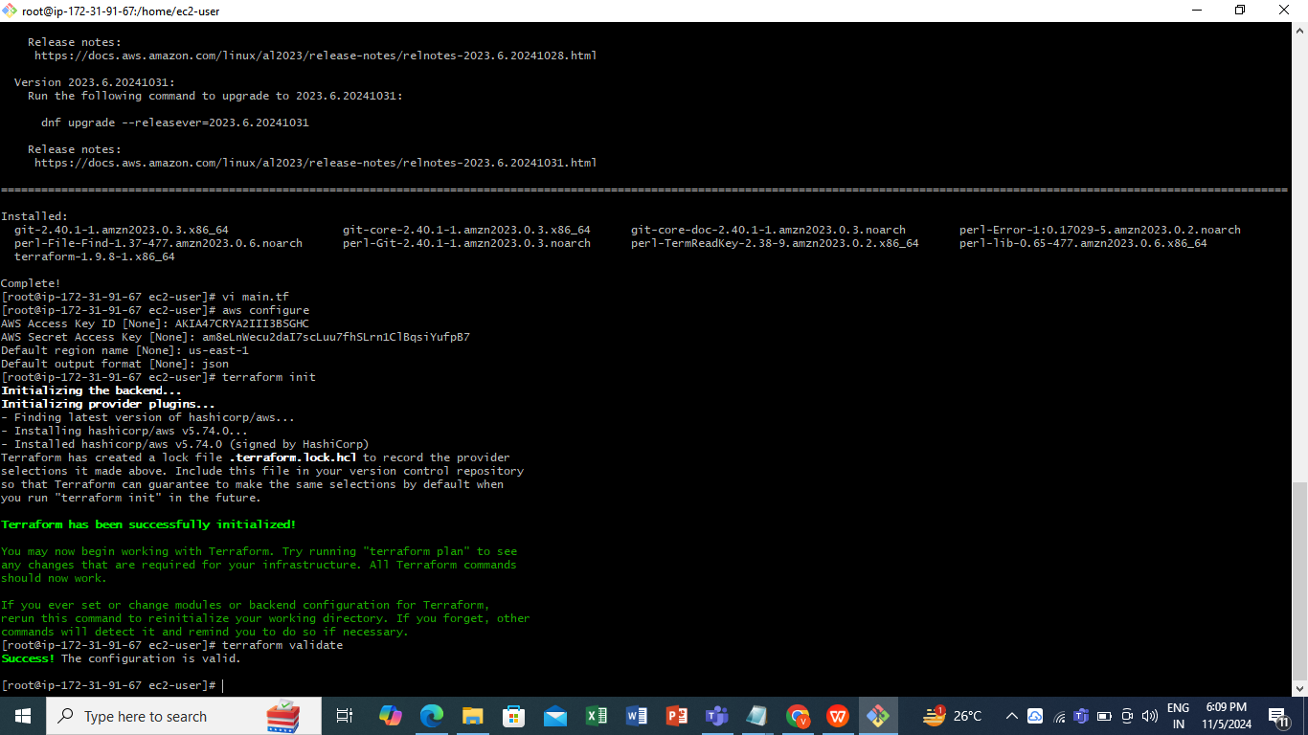
terraform validate :-
The terraform validate command is used to check the syntax and structure of your Terraform configuration files (.tf files) for correctness. It performs a validation to ensure that your configuration is syntactically valid and that it doesn't contain any obvious errors that would prevent it from being applied.

Slide 14
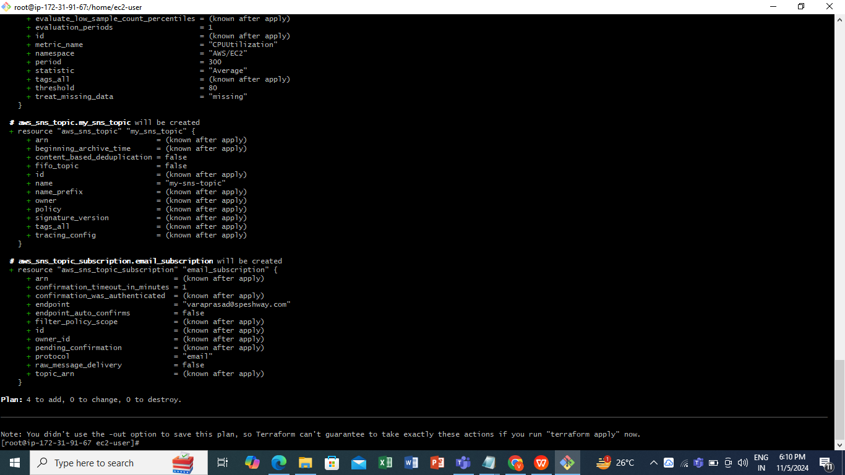
terraform plan :-
The terraform plan command is one of the most important commands in Terraform. It is used to preview the changes that Terraform will make to your infrastructure before actually applying those changes. In other words, terraform plan shows you what actions Terraform will take (e.g., create, modify, or destroy resources) in response to the configuration you have defined.

Slide 15
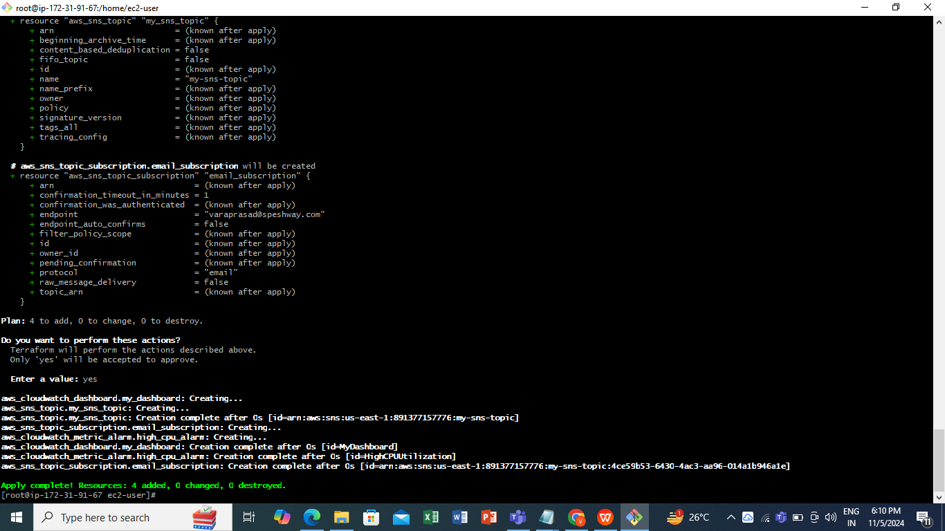
terraform apply :-
The terraform apply command is used to apply the changes specified in your Terraform configuration to your infrastructure. It makes the changes in your environment based on the execution plan that was created during terraform plan or the configuration itself.
In essence, terraform apply is the command that actually creates, updates, or destroys resources in your cloud or on-premises environment, based on the configuration you defined in your .tf files.

Slide 16
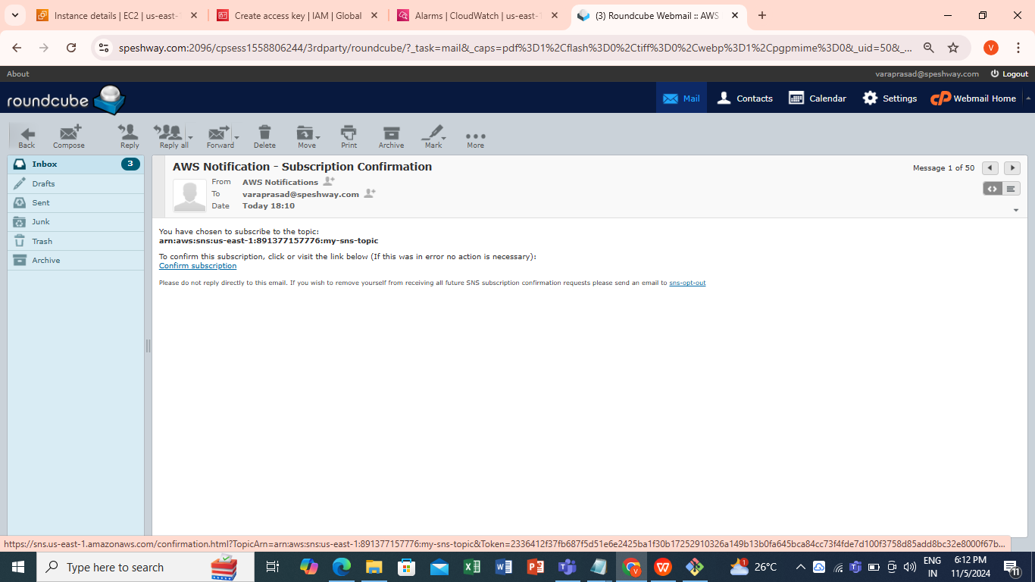
Confirm Subscription:
After applying the configuration, check your email for a subscription confirmation from SNS. You need to confirm the subscription for the alerts to be sent.

Slide 17
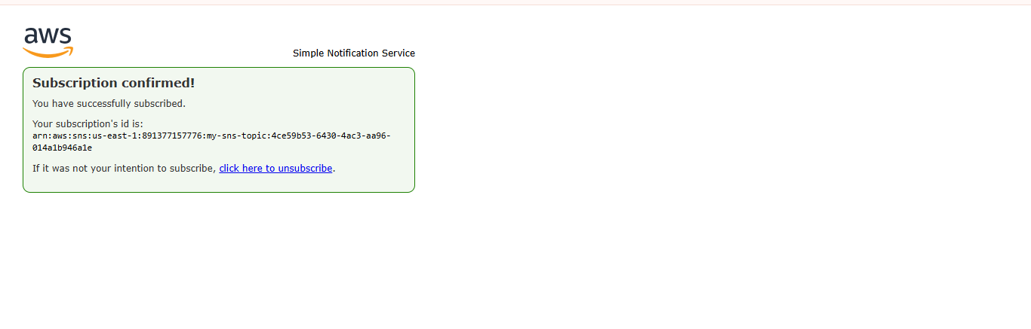
confirm subscription :-
After you create an SNS subscription in your Terraform code (or through the AWS Console), Amazon SNS will send a subscription confirmation email to the email address you provided.

Slide 18
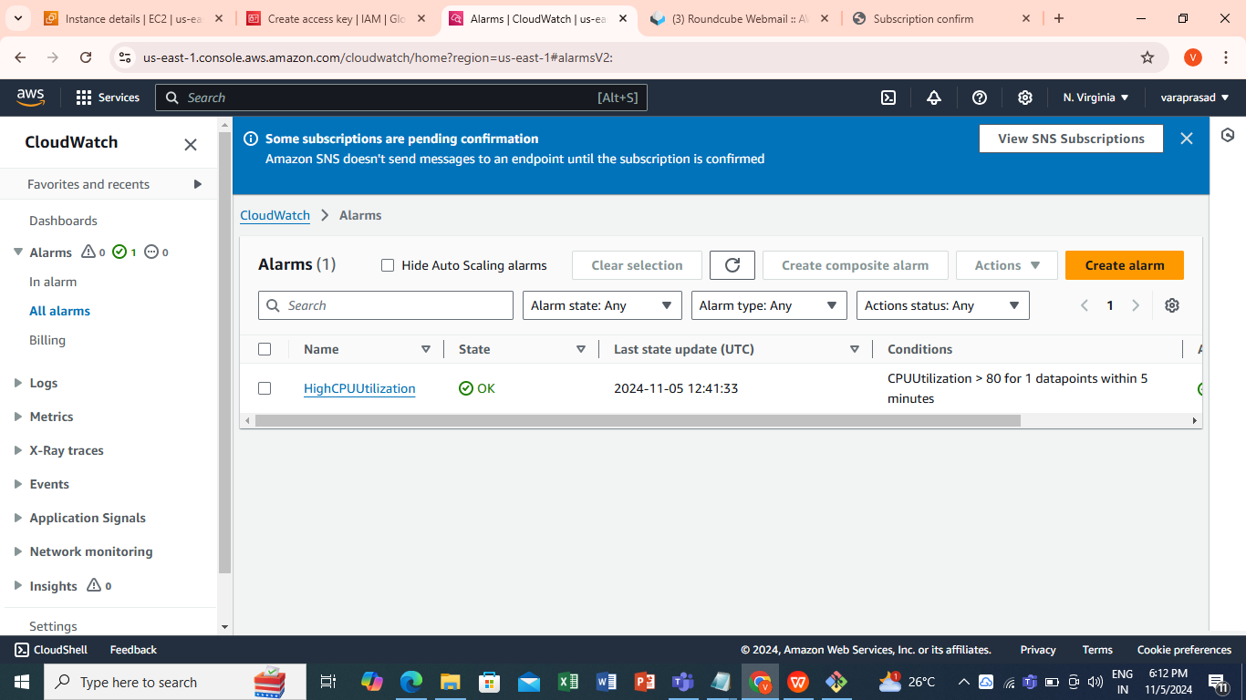
alarm has been created

Slide 19
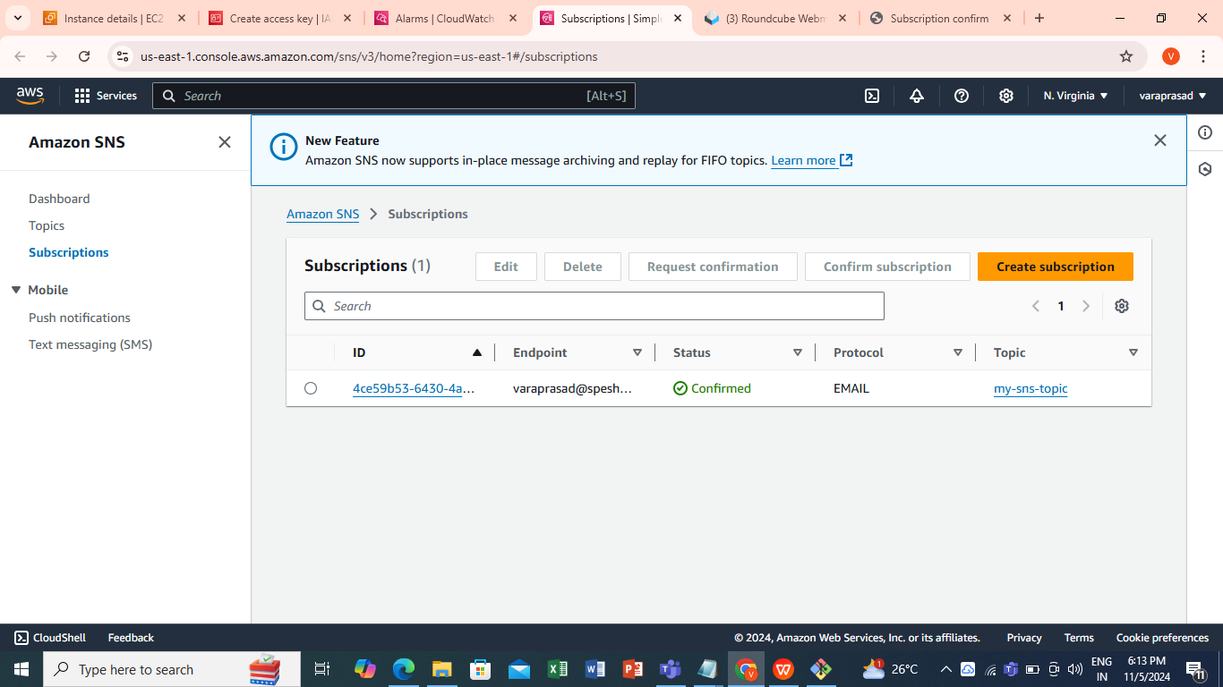
sns has been created

Slide 20
thank you

